Slide 1
Transport Layer

Slide 2
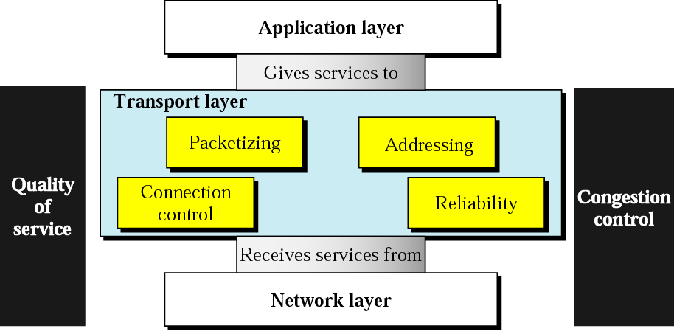
Position of transport layer

Slide 3
Introduction:
The transport layer is responsible for process-to-process delivery.

Slide 4
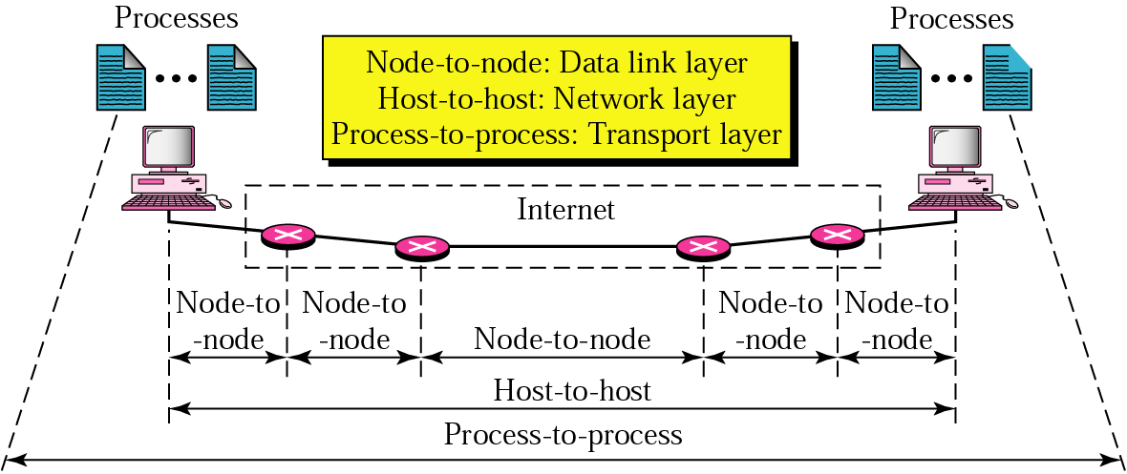
Types of data deliveries

Slide 5
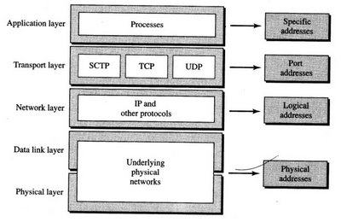
Position of Transport layer protocol in TCP/IP

Slide 6
1] UDP:
Connectionless Protocol.
Unreliable Protocol.
2] TCP:
Connection Oriented Protocol.
Reliable Protocol.
3] SCTP: Stream Control Transmission Protocol
Designed for multimedia, multihomed and multistream application

Slide 7
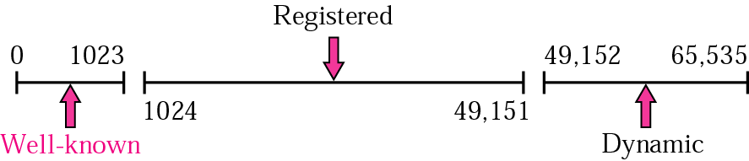
Port numbers
IANA (Internet Assigned Number Authority) ranges:

Slide 8
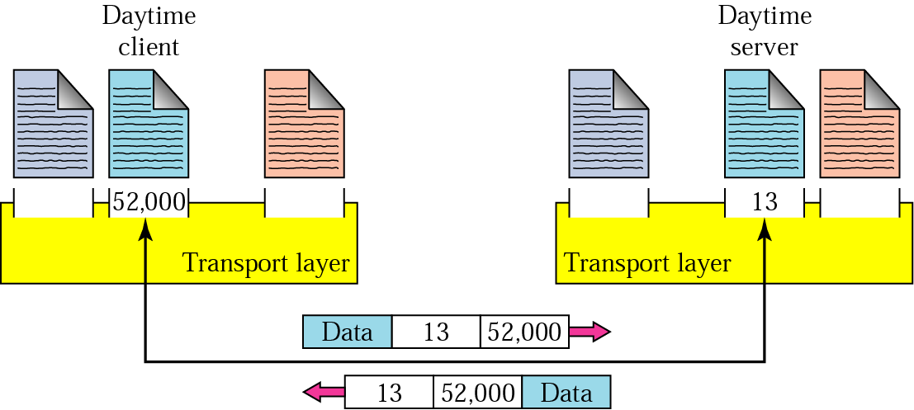
Port numbers

Slide 9
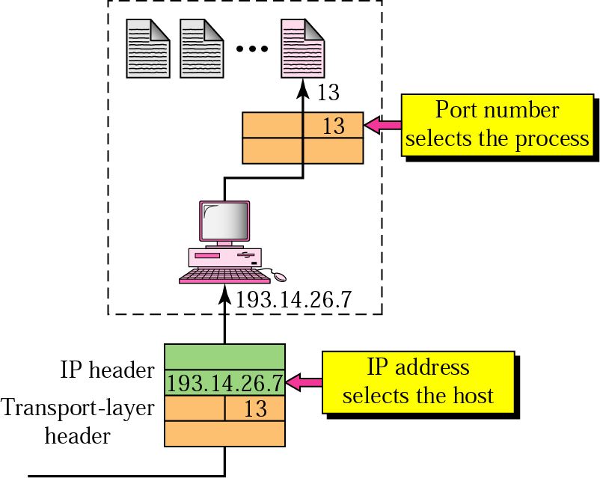
IP addresses versus port numbers

Slide 10
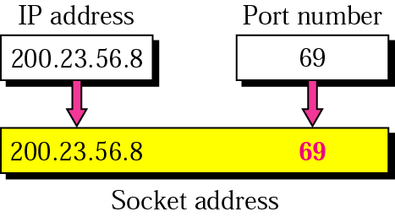
Socket address

Slide 11
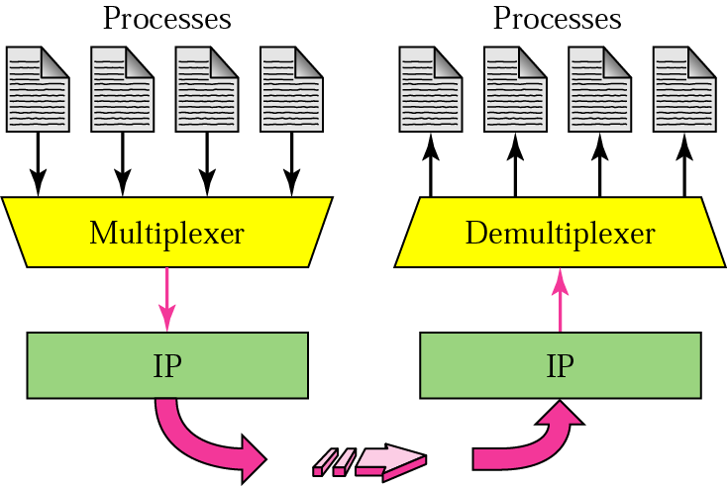
Multiplexing and Demultiplexing

Slide 12
Connectionless Protocol Vs
Connection Oriented Protocol.
Reliable Versus Unreliable.

Slide 13
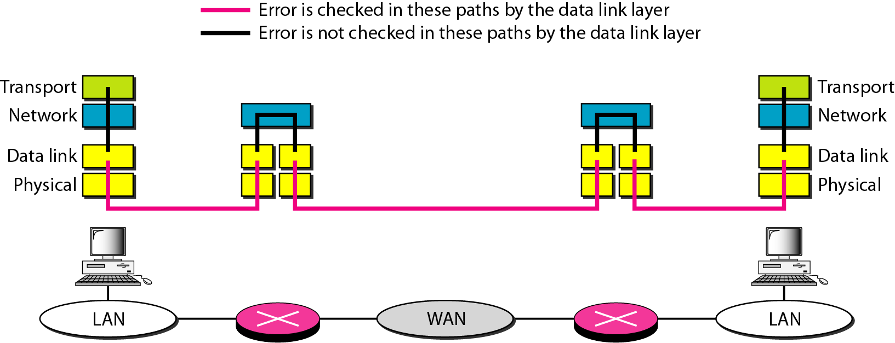
Error control

Slide 14
USER DATAGRAM PROTOCOL (UDP)
The User Datagram Protocol (UDP) is called a connectionless, unreliable transport protocol. It does not add anything to the services of IP except to provide process-to-process communication instead of host-to-host communication.
Also, it performs very limited error checking.
UDP is so powerless.

Slide 15
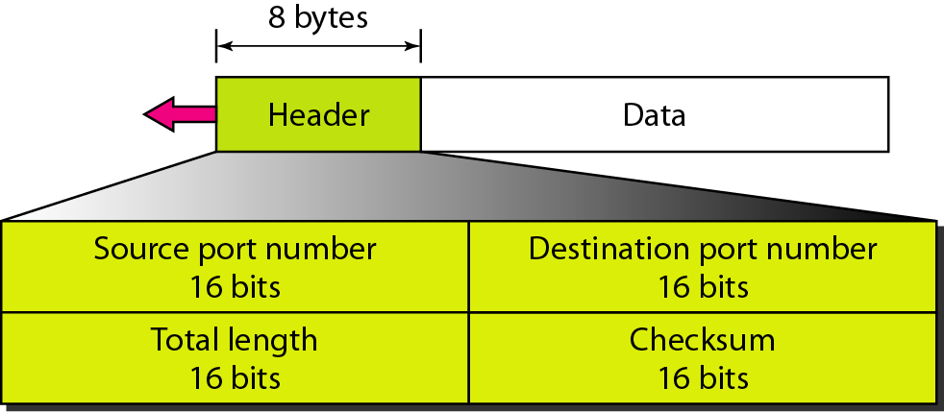
User datagram format

Slide 16
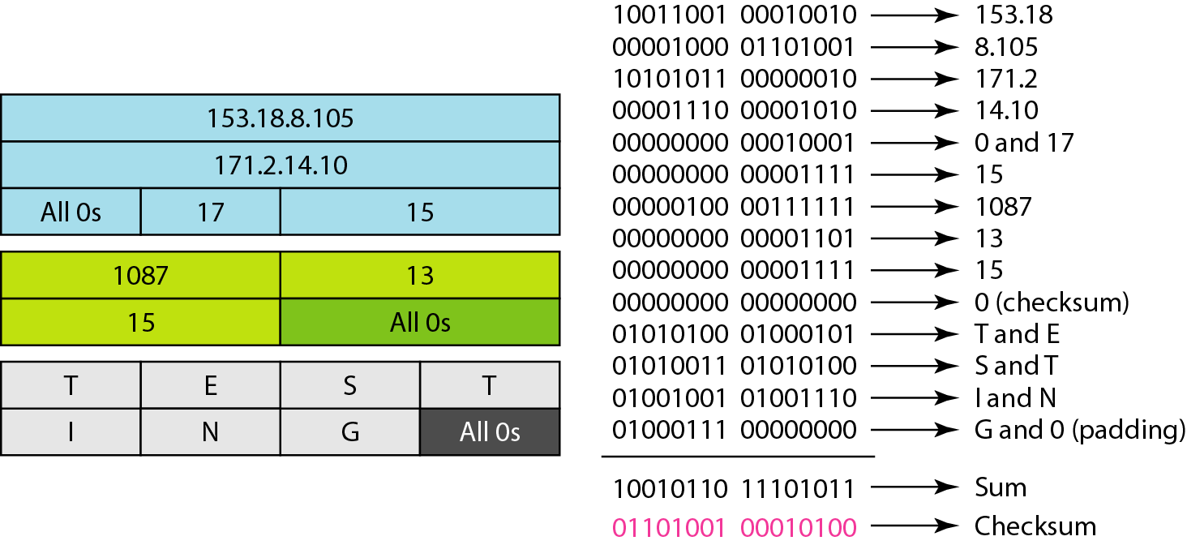
Checksum calculation of a simple UDP
user datagram

Slide 17
TCP
TCP is a connection-oriented protocol; it creates a virtual connection between two TCPs to send data. In addition, TCP uses flow and error control mechanisms at the transport level.

Slide 18
TCP Services
1] Process-to-Process Communication

Slide 19
Well-known ports used by TCP

Slide 20
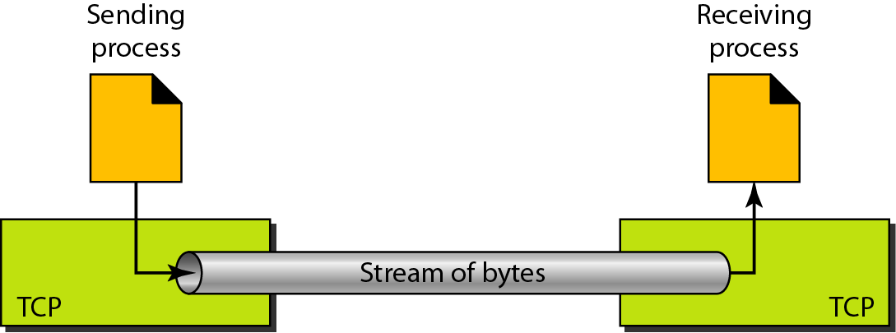
2] Stream delivery Service
Two processes seem to be connected by an imaginary "tube“ that carries their data across the Internet.
The sending process produces (writes to) the stream of bytes, and the receiving process consumes (reads from) them.

Slide 21
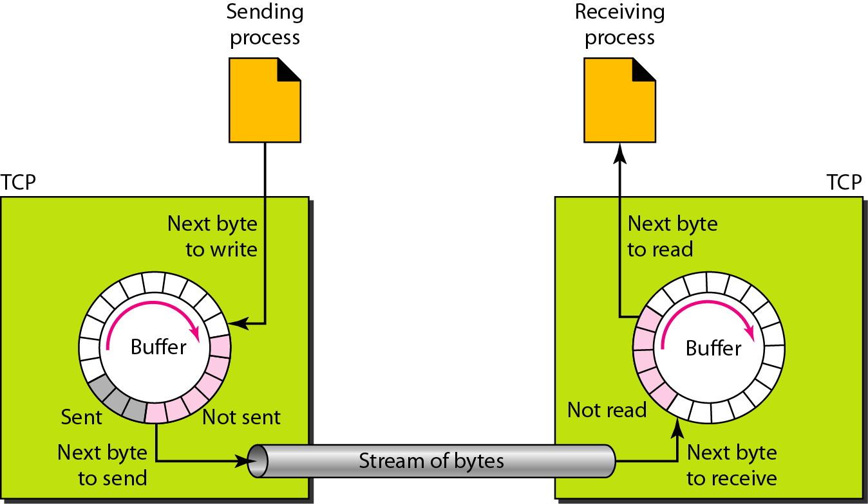
3] Sending and receiving buffers

Slide 22
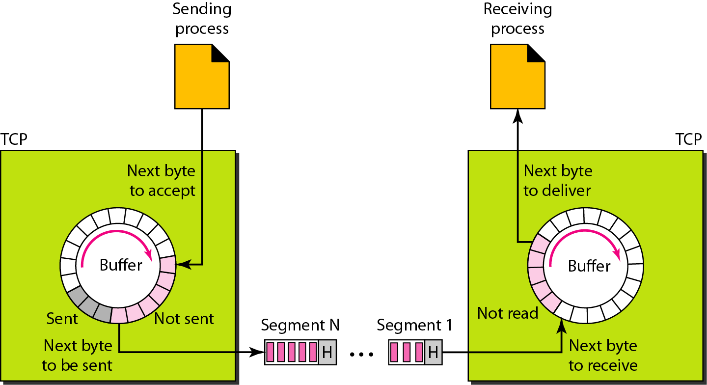
4] TCP segments

Slide 23
5] Full-Duplex Communication
6] Connection-Oriented Service
7] Reliable Service.

Slide 24
TCP Features
1] Numbering System
2] Byte Number
3] Sequence Number
4] Acknowledgment Number
5] Flow Control
6] Error Control
7] Congestion Control

Slide 25
2] Byte Number:
The numbering does not necessarily start from O. Instead, TCP generates a random number between 0 and 2³² - 1 for the number of the first byte.
Byte numbering is used for flow and error control.

Slide 26
3] Sequence Number:
After the bytes have been numbered, TCP
Assigns a sequence number to each segment that
is being sent. The sequence number for each
segment is the number of the first byte carried in
that segment.

Slide 27
4] Acknowledgment Number:
The acknowledgment number defines the number of the next byte that the party expects to receive.
The acknowledgment number is cumulative,
which means that the party takes the number of the last byte that it has received,
safe and sound, adds 1 to it, and announces this sum as the acknowledgment number.

